Slide 1
DAA432C
ASSIGNMENT 02
Presented by
-Anirudh Gupta (IIT2019228)
-Navneet Bhole (IIT2019229)
-Eshan Vaid (IIT2019230)

Slide 2
CONTENTS
Problem Statement
Algorithm
Algorithm Implementation
Time Complexity Analysis
Space Complexity Analysis
Time Complexity Graph
Space Complexity Graph
Results

Slide 3
PROBLEM STATEMENT
Use divide and conquer to find stain in a cloth image. Take assumption for cloth image by your own.

Slide 4
DIVIDE AND CONQUER
Divide and Conquer is an algorithmic paradigm similar to Greedy and Dynamic Programming. A typical Divide and Conquer algorithm solves a problem using the following three steps.
Divide: Break the given problem into subproblems of same type. This step generally takes a recursive approach to divide the problem until no sub-problem is further divisible.
Conquer: Recursively solve these sub-problems.
Combine: Appropriately combine the answers. When the smaller sub-problems are solved, this stage recursively combines them until they formulate a solution of the original problem.
Binary search is an example of Divide and Conquer algorithm. It has been used to solve above mentioned problem.

Slide 5
ALGORITHM IMPLEMENTATION
Following are the cases that we consider in our algorithm Every time we go to the middle element and decide our next move based on the following cases :
Case 1: If the middle element is smaller than the element on the left side and also smaller than the element on the right side then it is the least element in that row.
Case 2: If the middle element is not the least element, then check if the element on the left side is greater than the middle element then we will search on the right side of the middle element.
Case 3: If the element on the right side is greater than the middle element then we will search on the left side of the middle element. Until the case 1 is satisfied and lo is lesser or equal to hi the above cycle is repeated.

Slide 6
TIME COMPLEXITY ANALYSIS
Time Complexity:
Time complexity is the number of operations an algorithm performs to complete its task (considering that each operation takes the same amount of time). The algorithm that performs the task in the smallest number of operations is considered the most efficient one in terms of the time complexity.
We are iterating each row and then using binary search we are finding out the minimum element in the row so the overall time complexity would be O(mlogn) where m = number of rows, n = number of columns.

Slide 7
SPACE COMPLEXITY ANALYSIS
Space Complexity:
The space complexity of an algorithm is the amount of memory space required to solve an instance of the computational problem as a function of characteristics of the input. It is the memory required by an algorithm until it executes completely.
Since we have not used any extra data structure in our algorithm so the space complexity would be O(1).

Slide 8
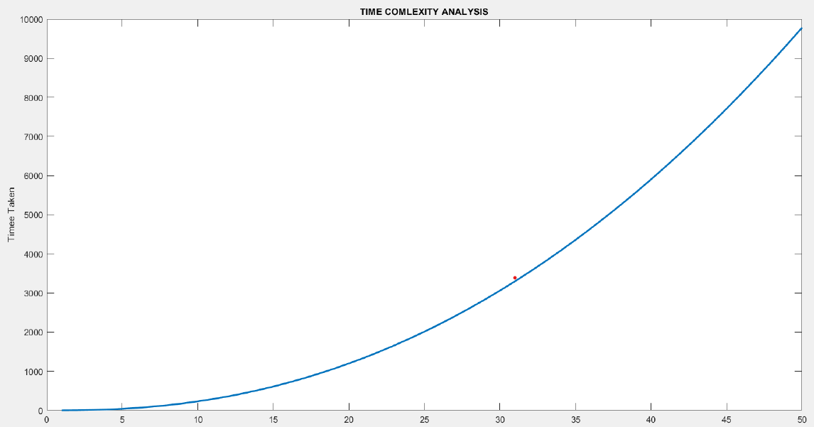
TIME COMPLEXITY GRAPH

Slide 9
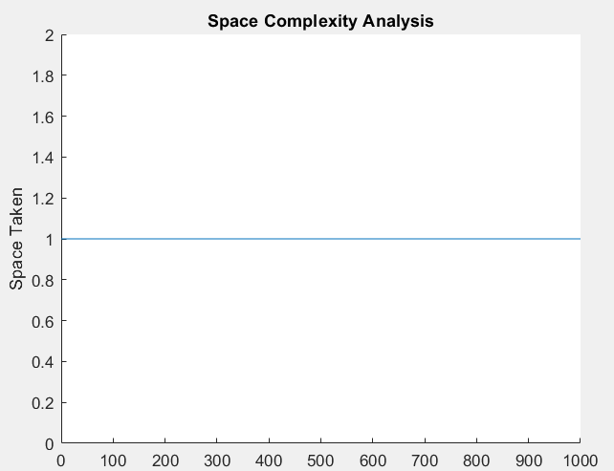
SPACE COMPLEXITY GRAPH

Slide 10
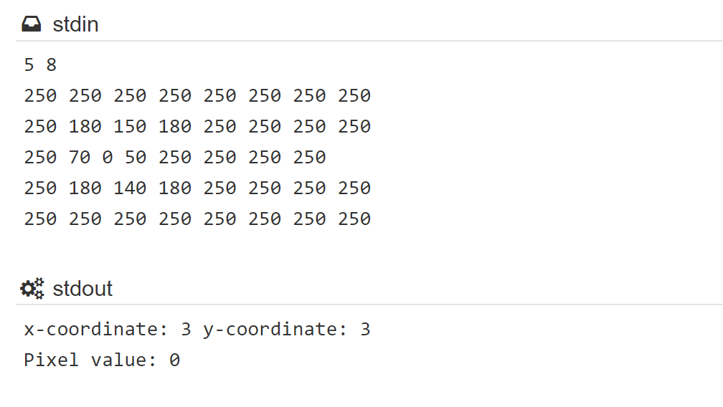
RESULTS

Slide 11
THANK YOU

